Slide 1
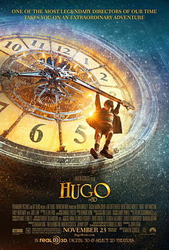
Hugo 2011

Slide 2
Thursday, November 13, 2013
JOURNAL: What do you think of the film Hugo, and why?
Today:
1. Notes on Hugo
2

Slide 3
Write what is it red!
Hugo is a 2011 3D fantasy adventure drama film set in Paris, France based on Brian Selznick's novel The Invention of Hugo Cabret about a boy who lives alone in a Paris railway station and the enigmatic owner of a toy shop there. It is directed by Martin Scorsese and written by John Logan.

Slide 4
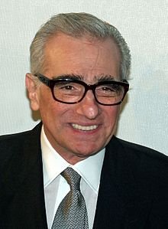
Martin Scorsese
American film director, screenwriter, producer, actor, and film historian
hailed as one of the most significant and influential American filmmakers of all time, directing landmark films such as Mean Streets (1973), Taxi Driver (1976), Raging Bull (1980), and Goodfellas (1990)
recipient of the AFI Life Achievement Award for his contributions to the cinema, and has won Academy Award, Emmys, Golden Globes, BAFTAs, and DGA Awards

Slide 5
Hugo is Scorsese's first film shot in 3D, of which the filmmaker remarked: "I found 3D to be really interesting, because the actors were more upfront emotionally. Their slightest move, their slightest intention is picked up much more precisely.”

Slide 6
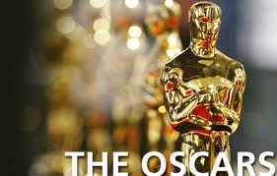
Hugo was nominated for 11 Academy Awards, making it the most nominated film of 2011, including a Best Picture nomination and a Best Director nomination for Martin Scorsese, and the film won five: Best Sound Mixing, Best Sound Editing, Best Art Direction, Best Visual Effects and Best Cinematography.

Slide 7
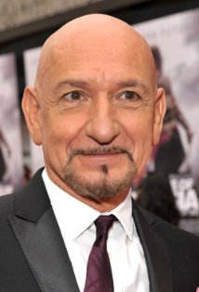
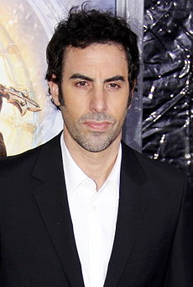
]
Ben Kingsley .. Georges Méliès
English Actor known for starring as Mohandas Gandhi in the film Gandhi in 1982, for which he won the Academy Award for Best Actor. He is also known for his performances in the films Schindler's List (1993), Sexy Beast (2000) and House of Sand and Fog (2003).
Sacha Baron Cohen .. Station Inspector
English stand-up comedian, writer, actor, and voice artist. A graduate of Cambridge University, he is most widely known for writing and playing three unorthodox fictional characters Ali G, Borat, and Brüno. In his routines, Baron Cohen's characters interact with unsuspecting people who do not realise they are being set up for comic situations and self-revealing ridicule.

Slide 8
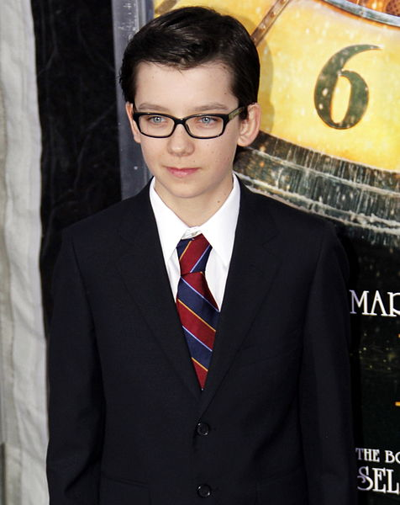
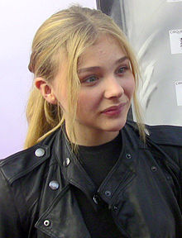
Asa Butterfield as Hugo Cabret
English actor, best known for starring in the Holocaust film The Boy in the Striped Pyjamas (2008), playing Norman in the 2010 film Nanny McPhee and the Big Bang
Chloë Grace Moretz as Isabelle, Georges' goddaughter
American Actress- At the age of seven, she began her acting career with performances in films and series such as The Amityville Horror, (500) Days of Summer, Diary of a Wimpy Kid, Desperate Housewives, and Dirty Sexy Money, for which she received numerous Young Artist Awards nominations.
- received worldwide recognition for her breakthrough performance as Hit-Girl in the 2010 superhero film Kick-Ass.

Slide 9
Other cast
Ray Winstone as Claude Cabret, Hugo's uncle.
Jude Law as Hugo's father, a clockmaker
Christopher Lee as Monsieur Labisse, the bookshop owner
Helen McCrory as Mama Jeanne, Georges' wife
Michael Stuhlbarg as René Tabard, a film historian

Slide 10
Filming Locations
Hugo was filmed at London’s Shepperton Studios as well as on locations in London, Paris and the Nene Valley Railway near Peterborough, who also loaned their original Compagnie Internationale des Wagons-Lits rolling stock to the studio.

Slide 11
Trivia
Martin Scorsese's first PG rated film in 18 years.
Director Cameo:
Martin Scorsese: the photographer taking a picture of young George Melies outside his new studio and a minute later his voice can be heard in Melies' studio saying "good, that's good, yes".

Slide 12
“The Gare Montparnasse became famous for the derailment on 22 October 1895 of the Granville–Paris Express, which overran the buffer stop. The engine careered across the station concourse, crashed through a thick wall, shot across a terrace and smashed out of the station, plummeting onto the Place de Rennes. Two of the 131 passengers sustained injuries, along with the fireman and two conductors. A woman on the street below was killed by falling masonry. A conductor was given a 25-franc fine and the engine driver a 50-franc fine.”

Slide 17
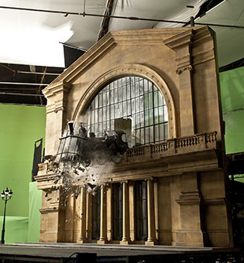

Slide 19
Part 2
Journal entry
Hugo won an academy award for Best Visual Effects and Best Cinematography. From what you have seen so far do you agree that Hugo has great visual effects and cinematography? Why or why not?

Slide 20
Historical Elements!
The overall backstory and primary features of Georges Méliès' life as depicted in the film are largely accurate:
he did become interested in film after seeing a demonstration of the Lumière brothers' camera, he was a magician and toymaker,
he experimented with automata, he did own a theatre (Theatre Robert-Houdin),
he was forced into bankruptcy,
his film stock was reportedly melted down for its cellulose,
he became a toy salesman at the Montparnasse station,
and he was eventually awarded the Légion d'honneur (Legion of honor) medal after a period of terrible neglect.
Many of the early silent films shown in the movie are Méliès's actual works, such as Le voyage dans la lune (1902).

Slide 21
Goofs
In the two scenes with a close-up on the tracks, you can see the rail fixed to cross-ties by Pandrol clips, instead of traditional bolts. Pandrol clips were used for the first time in 1957.
The movie is set in 1931. From 1925 to 1934 the Eiffel tower had illuminated signs for Citroën adorned three of the tower's four sides. However in the movie the lights on the tower are as they are today, with no Citroën sign on it.

Slide 22
Character erros
In the old footage you see ALL women with unshaven armpits however in the recreated history by Scorsese, Georges Melliers' wife Jeanne (Helen McCrory) appears with modern clean shaven armpits.
(At 01:08) When the Station Inspector first talks to Lisette he comments on the "Posies", asks if they are smelly and smells them, and then Lisette places one in his uniform. However, the flowers that they point to, smell, and place are all actually Irises, not Posies.

Slide 23
Continuity Errors
After Tabar finishes the showing "Earth to the Moon", the reel is still full. When Méliès enters the room the reel is empty
When Georges tells Hugo that he has to work for him, a doll in the foreground changes places.

Slide 24
Related websites for teachers
http://eduscapes.com/library/i/invention_of_hugo_cabret.htm

